Slide 1
Generative Models VAE/GAN
Taeoh Kim, MVP LAB Seminar
Episode 1b - 2017.7.7

Slide 2
GAN
새로운 Model 개발로
P(x)를 구해보자

Slide 3
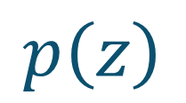
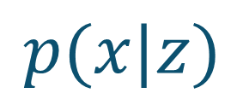
GAN: Idea
Generated
Output
$$p\left(z\right)$$
$$p(x|z)$$

Slide 4
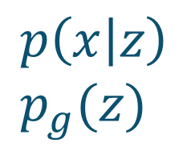
GAN: Idea
Generated
Output
$$p\left(z\right)$$
$$p\left(x | z\right) \\ p_{g}(z)$$
Input
Image
Real?
Fake?
Discriminator

Slide 5
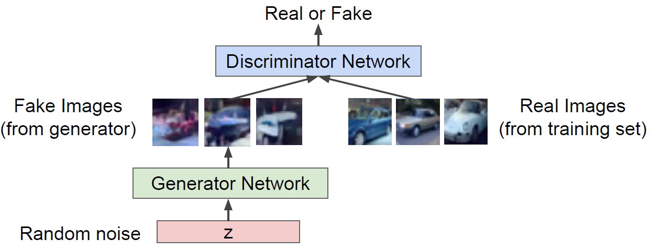
GAN: Idea
$$\min_{G}{\max_{D}{V(D, G)}}=E_{x\sim p_{data}}\left[\log{D\left(x\right)}\right]+E_{z\sim p(z)}[\log\left(1−D\left(G\left(z\right)\right)\right)]$$
Images from cs231n

Slide 6
GAN: Objective Minimax Problem
$$\min_{G}{\max_{D}{V(D, G)}}=E_{x\sim p_{data}}\left[\log{D\left(x\right)}\right]+E_{z\sim p(z)}[\log\left(1−D\left(G\left(z\right)\right)\right)]$$
Generated Image

Slide 7
GAN: Objective Minimax Problem
$$\min_{G}{\max_{D}{V(D, G)}}=E_{x\sim p_{data}}\left[\log{D\left(x\right)}\right]+E_{z\sim p(z)}[\log\left(1−D\left(G\left(z\right)\right)\right)]$$
data pdf
generator pdf

Slide 8
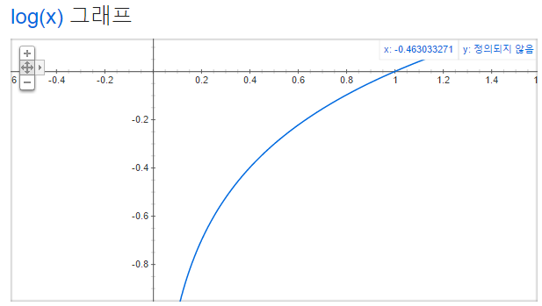
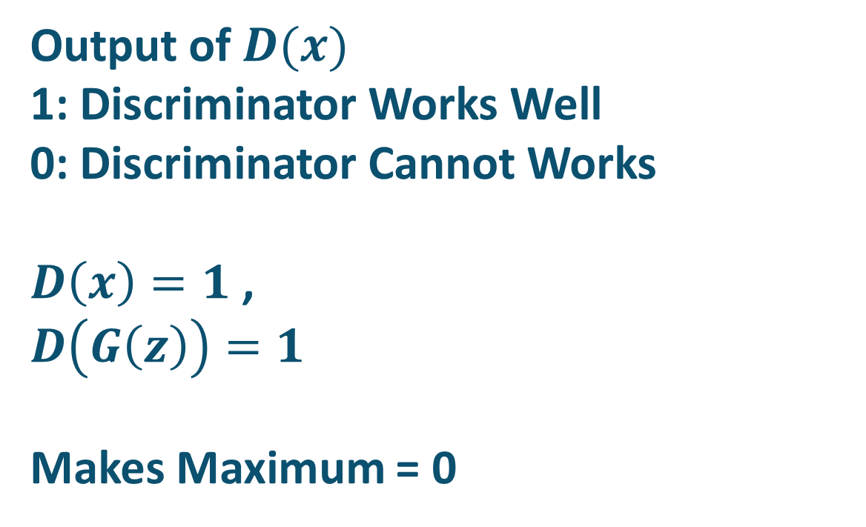
GAN: Objective Minimax Problem
$$\min_{G}{\max_{D}{V(D, G)}}=E_{x\sim p_{data}}\left[\log{D\left(x\right)}\right]+E_{z\sim p(z)}[\log\left(1−D\left(G\left(z\right)\right)\right)]$$
Output of $D(x)$
1: Discriminator Works Well
0: Discriminator Cannot Works
$D\left(x\right)=1$ , $D\left(G\left(z\right)\right)=1$
Makes Maximum = 0

Slide 9
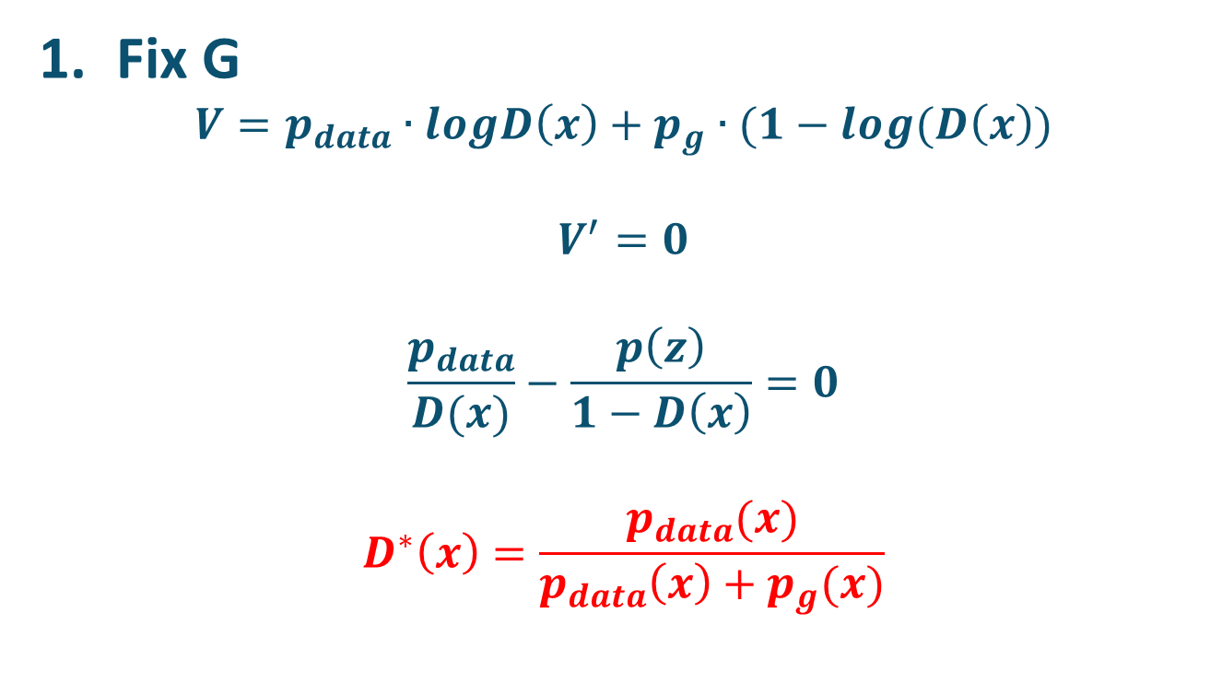
GAN: Is Solution Exist?
$$\min_{G}{\max_{D}{V(D, G)}}=E_{x\sim p_{data}}\left[\log{D\left(x\right)}\right]+E_{z\sim p(z)}[\log\left(1−D\left(G\left(z\right)\right)\right)]$$
Fix G
$$V=p_{data}∙logD\left(x\right)+p_{g}∙(1−log(D\left(x\right))$$
$$V^{′}=0$$
$$\frac{p_{data}}{D(x)}−\frac{p\left(z\right)}{1−D\left(x\right)}=0$$
$$D^{∗}\left(x\right)=\frac{p_{data}(x)}{p_{data}\left(x\right)+p_{g}(x)}$$

Slide 10
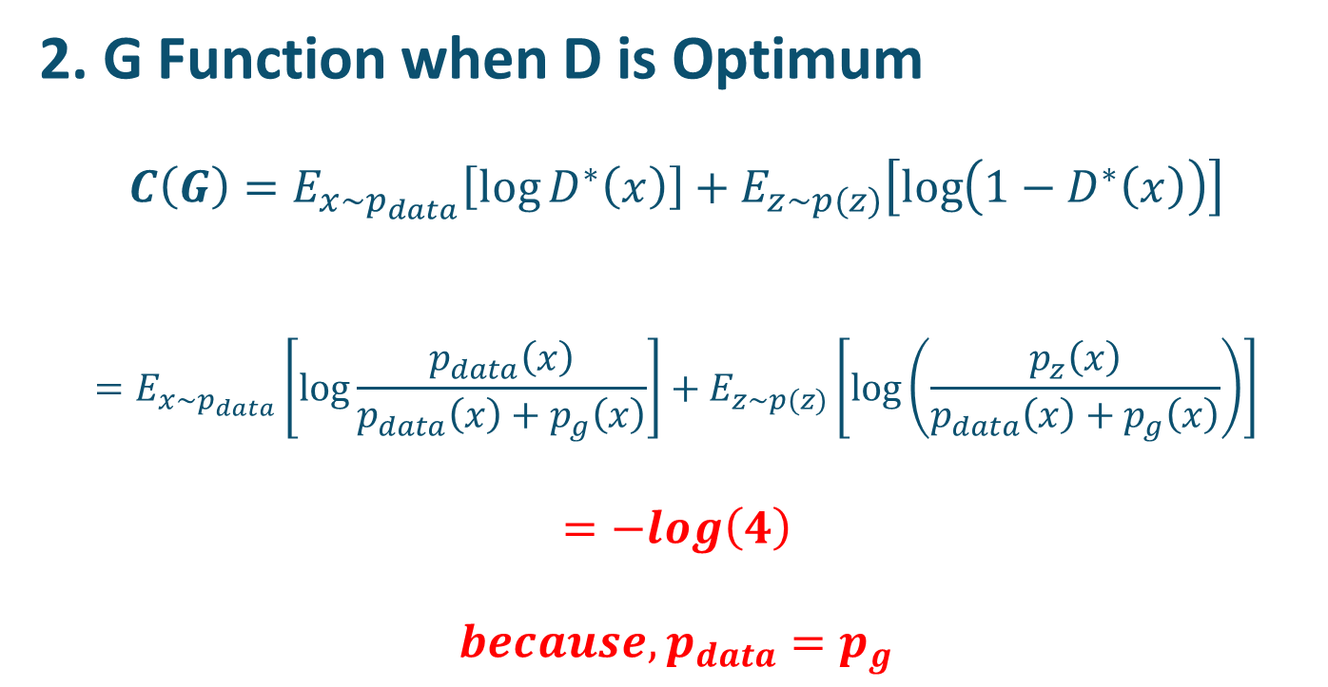
GAN: Is Solution Exist?
$$\min_{G}{\max_{D}{V(D, G)}}=E_{x\sim p_{data}}\left[\log{D\left(x\right)}\right]+E_{z\sim p(z)}[\log\left(1−D\left(G\left(z\right)\right)\right)]$$
2. G Function when D is Optimum
$$C\left(G\right)=E_{x\sim p_{data}}\left[\log{D^{∗}\left(x\right)}\right]+E_{z\sim p(z)}\left[\log\left(1−D^{∗}\left(x\right)\right)\right]$$
$$=E_{x\sim p_{data}}\left[\log{\frac{p_{data}\left(x\right)}{p_{data}\left(x\right)+p_{g}\left(x\right)}}\right]+E_{z\sim p(z)}\left[\log\left(\frac{p_{z}\left(x\right)}{p_{data}\left(x\right)+p_{g}\left(x\right)}\right)\right]$$
$$=−log\left(4\right)$$
$$because, p_{data}=p_{g}$$

Slide 11
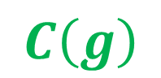
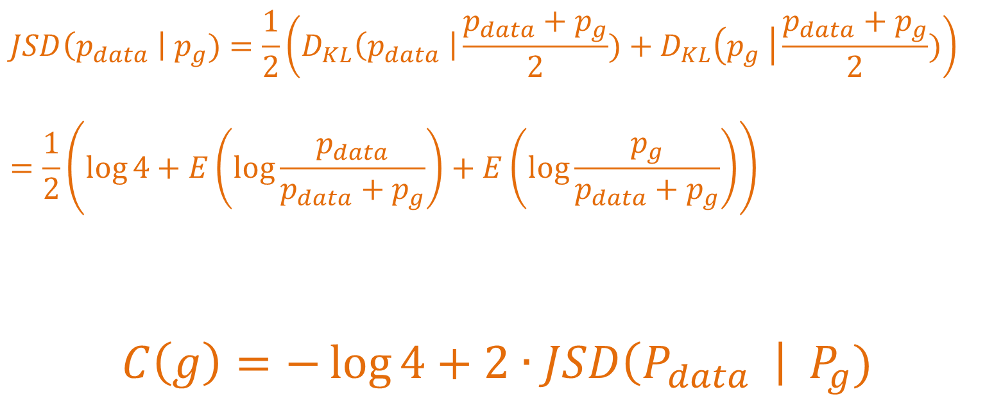
GAN: Some Backgrounds..
JS Divergence: Jensen-Shannon Divergence
$$JSD\left(p_{data} \right| p_{g})=\frac{1}{2}\left(D_{KL}\left(p_{data} \right|\frac{p_{data}+p_{g}}{2})+D_{KL}\left(p_{g} \right|\frac{p_{data}+p_{g}}{2})\right)$$
$$=\frac{1}{2}\left(\log{4}+E\left(\log{\frac{p_{data}}{p_{data}+p_{g}}}\right)+E\left(\log{\frac{p_{g}}{p_{data}+p_{g}}}\right)\right)$$
$$C\left(g\right)=−\log{4}+2∙JSD\left(P_{data} \right| P_{g})$$
$$C\left(g\right)$$

Slide 12
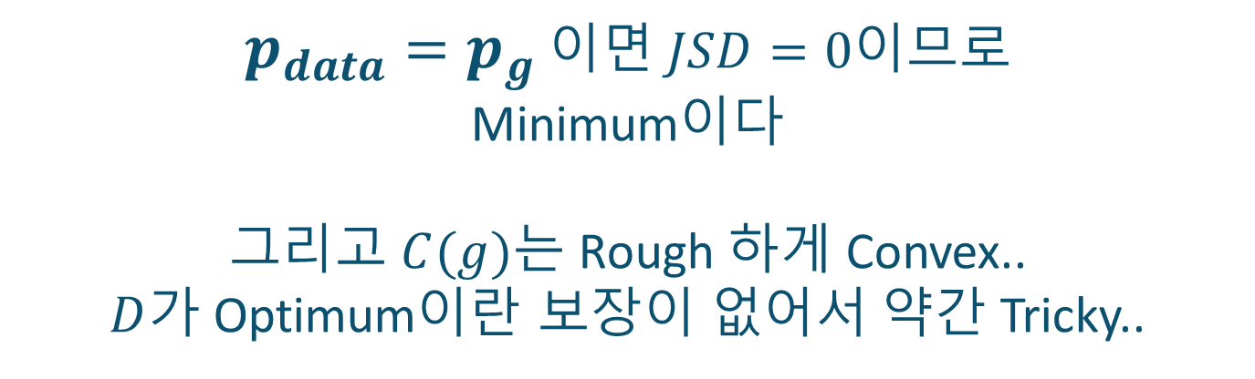
GAN: Solution is Exist !
$$C\left(g\right)=−\log{4}+2∙JSD\left(P_{data} \right| P_{g})$$
$p_{data}=p_{g}$ 이면 $JSD=0$이므로
Minimum이다
그리고 $C(g)$는 Rough 하게 Convex..
$D$가 Optimum이란 보장이 없어서 약간 Tricky..

Slide 13
GAN
Solution으로 가는 알고리즘??
이게 어렵다!
GAN의 단점.
GAN Original Paper에서는 이 부분의
수학적 증명이 빈약하다.
이로 인해 수많은 후속 GAN을 탄생시켰다.

Slide 14
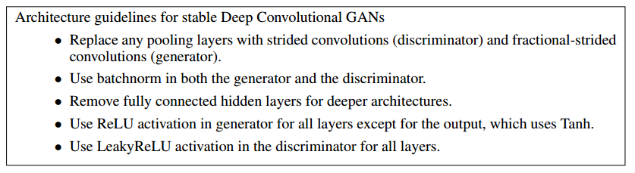
DCGAN
Deep Convolutional - GAN
GAN을 안정화시키고, 성능을 올리기 위해
여러가지를 제시한 논문
소소한 Tip 등등이 존재하지만 깊은 수학적 증명은 없다.
Pooling을 Convolution으로 구현하라
Batch Normaliztion을 사용하라
Fully-Connected Layer를 쓰지 마라
ReLU를 쓰고 Discriminator에서는 LeakyReLU를 써라

Slide 15
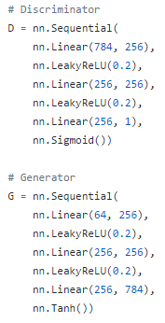
GAN: Implementation
PyTorch/Ubuntu14
https://github.com/yunjey/pytorch-tutorial/blob/master/tutorials/
02-intermediate/generative_adversarial_network/main.py

Slide 16
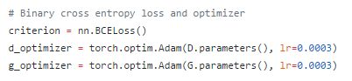
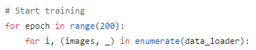
GAN: Implementation
PyTorch/Ubuntu14
https://github.com/yunjey/pytorch-tutorial/blob/master/tutorials/
02-intermediate/generative_adversarial_network/main.py

Slide 17
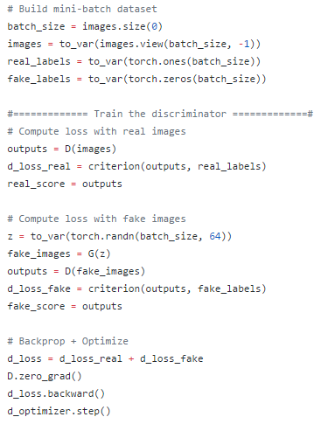
GAN: Implementation
real_labels = 1
fake_labels = 0
criterion = Binary Cross Entorpy
Discriminator의 Loss는
Real Image Input의 Real Label Loss와
Fake Image Input from Generator
의 Fake Label Loss의 합.

Slide 18
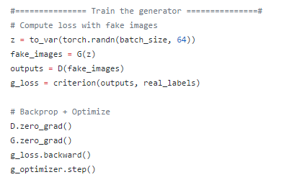
GAN: Implementation
Generator는
Generated된 Image가
Discriminant를 통과하여
최종 Flag에서
Real Label로 되도록 Loss를 설정
(Discriminant를 속여야 하므로)

Slide 19
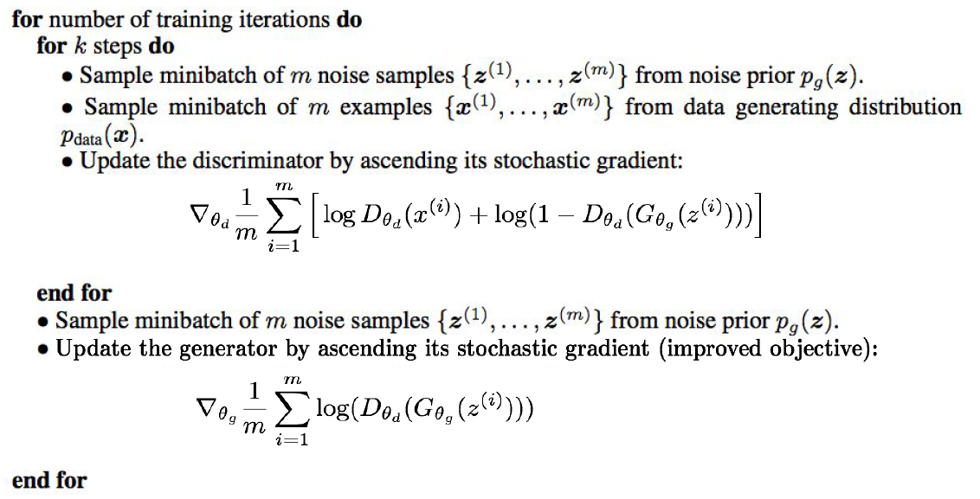
GAN: Implementation
Discriminator
Generator: 좀 더 유리하게

Slide 20
GAN: Results
Epoch [0/200], Step[300/600], d_loss: 0.2157, g_loss: 5.5566, D(x): 0.97, D(G(z)): 0.14
Epoch [0/200], Step[600/600], d_loss: 0.0885, g_loss: 4.9176, D(x): 0.99, D(G(z)): 0.06
Epoch [1/200], Step[300/600], d_loss: 3.3438, g_loss: 1.2540, D(x): 0.30, D(G(z)): 0.48
Epoch [1/200], Step[600/600], d_loss: 0.2958, g_loss: 3.8472, D(x): 0.93, D(G(z)): 0.13
Epoch [2/200], Step[300/600], d_loss: 0.7927, g_loss: 1.7361, D(x): 0.73, D(G(z)): 0.30
Epoch [2/200], Step[600/600], d_loss: 1.6413, g_loss: 1.7606, D(x): 0.59, D(G(z)): 0.37
Epoch [148/200], Step[300/600], d_loss: 0.8458, g_loss: 1.7945, D(x): 0.71, D(G(z)): 0.29
Epoch [148/200], Step[600/600], d_loss: 0.8420, g_loss: 1.8755, D(x): 0.73, D(G(z)): 0.29
Epoch [149/200], Step[300/600], d_loss: 1.0226, g_loss: 1.7892, D(x): 0.73, D(G(z)): 0.35
Epoch [149/200], Step[600/600], d_loss: 0.9316, g_loss: 1.9049, D(x): 0.68, D(G(z)): 0.26

Slide 21
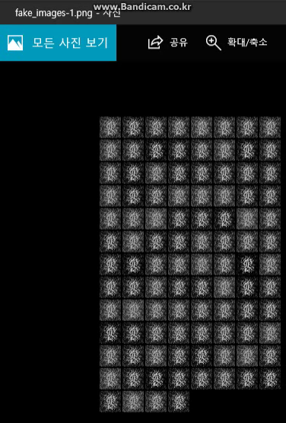
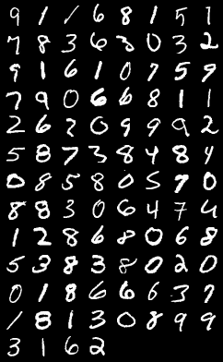
GAN: Results

Slide 22
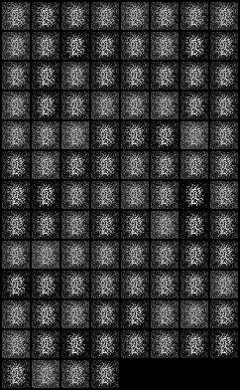
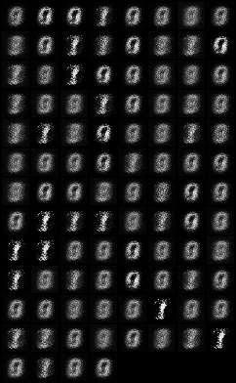
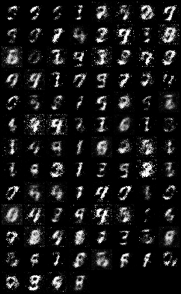
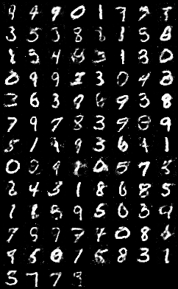
GAN: Results
Epoch 1
Epoch 10
Epoch 20
Epoch 100

Slide 23
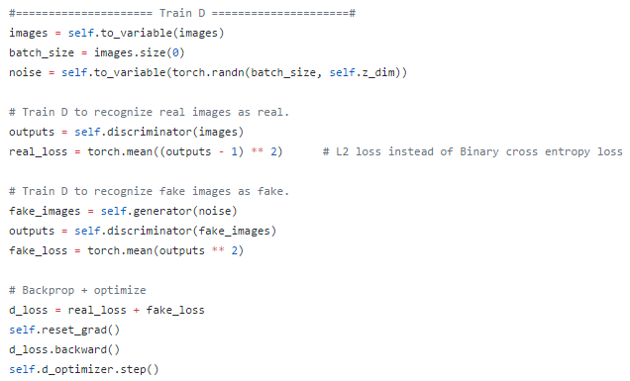
DCGAN: Implementation
PyTorch/Ubuntu14
https://github.com/yunjey/pytorch-tutorial/tree/master/tutorials/03-advanced/deep_convolutional_gan

Slide 24
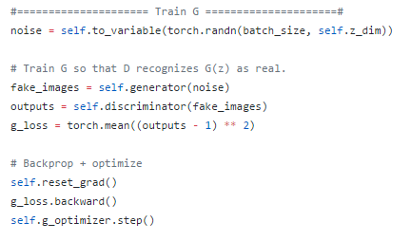
DCGAN: Implementation
PyTorch/Ubuntu14
https://github.com/yunjey/pytorch-tutorial/tree/master/tutorials/03-advanced/deep_convolutional_gan

Slide 25
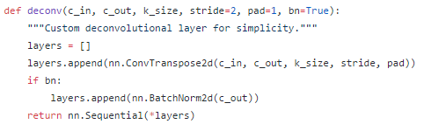
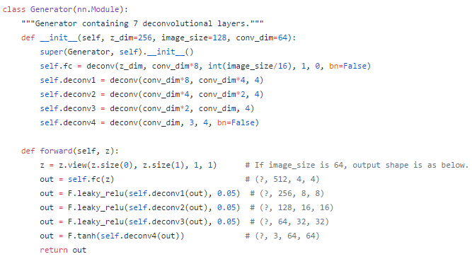
DCGAN: Implementation

Slide 26
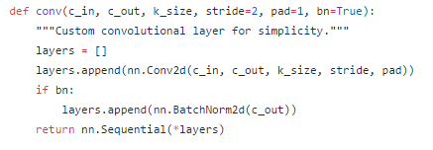
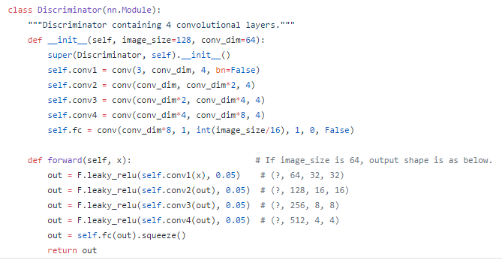
DCGAN: Implementation

Slide 27
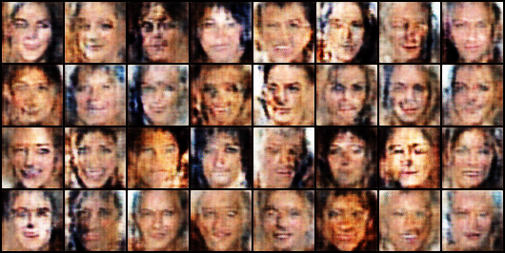
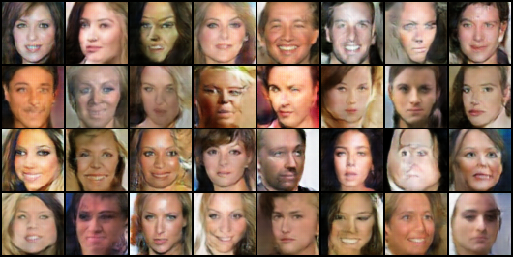
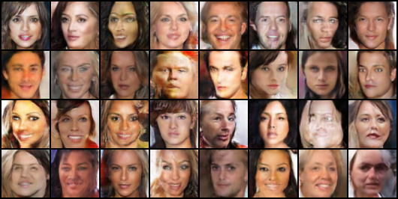
DCGAN: Results
Epoch 1
Epoch 6
Epoch 3

Slide 28
Trend of Generative Models
https://github.com/terryum/awesome-deep-learning-papers/blob/master/README.md
Hot (Important) Papers! (by Citation)
- Pixel-RNN, 2016
- Improved Techniques for Training GANs, 2016
- Unsupervised Representation Learning with Deep Convolutional Generative Adversarial Networks (DCGAN), 2015
- DRAW: A Recurrent Neural Network for Image Generation, 2015
- Generative Adversarial Nets (GAN), 2014
- Auto-Encoding Variational Bayes (VAE), 2013
- Build High-level Feature using Large Scale Unsupervised Learning, 2013

Slide 29
Trend of Generative Models
https://github.com/terryum/awesome-deep-learning-papers/blob/master/README.md
Recent Papers
Wasserstein GAN, 2017
KL과 JS로 사용되었던 GAN의 Objective Function을 Wasserstein Distance로 변경하여 안정적으로 수렴
GAN이 수학적 안정성을 찾아가는 듯 하다. 근데 요구되는 수학적
Background가 엄청나게 많다!!
NEED to STUDY!

Slide 30
You Can See Again
@
https://taeoh-kim.github.io/blog/blog/generative-models-part-1/

Slide 31
Thank You
Qusetion?

